Slide 1
Apache Spark supports two types of Operations-
Actions
Transformations

Slide 2
Actions
What is an action
The final stage of the workflow
Triggers the execution of the DAG
Returns the results to the driver
Or writes the data to HDFS or to a file

Slide 3
Spark Operations
Transformations (create a new RDD) | map filter sample groupByKey reduceByKey sortByKey intersection | flatMap union join cogroup cross mapValues reduceByKey
Actions (return results to driver program) | collect first Reduce take Count takeOrdered takeSample countByKey take save lookupKey foreach

Slide 4
Narrow Transformation
Wide Transformation
Narrow Transformation
Transformations that dose not result in data movement between partitions are called Narrow transformations. Functions such as map(), flatMap(), filter(), union() are some examples of narrow transformation
Wide Transformation
Transformations that involves data movement between partitions are called Wide transformations or shuffle transformations. Functions such as groupByKey(), aggregate(), aggregateByKey(), join(), repartition() are some examples of a wide transformations.

Slide 5
Narrow Vs. Wide transformation
Narrow
Vs.
Wide
A,1
A,[1,2]
A,2
Map
groupByKey

Slide 6
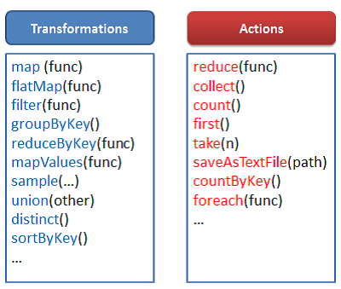

Slide 7
Spark Workflow
FlatMap
Map
groupbyKey
Collect
Spark Context
Driver Program

Slide 8
Job in Spark
When a spark application invoke an action like count(), first(), collect(), and save() is called on RDD (Resilient Distributed Datasets), DataFrame or Dataset, a job is created.
For every Job, a DAG visualization is created
A Job is a sequence of Stages, triggered by an Action
Driver converts your Spark application into one or more Spark jobs. It then transforms each job into a DAG.
By default, these Jobs are executed by Spark’s scheduler in keeping with the FIFO (first in, first out) ordering—the first job gets priority on all cluster resources

Slide 9
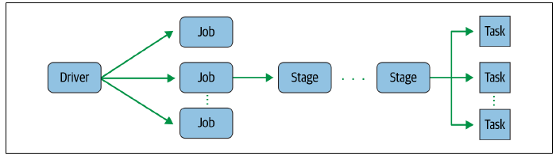

Slide 10
Spark Stages
A stage in Spark represents a sequence of transformations that can be executed in a single pass, without any shuffling of data Whenever there is a shuffling of data over the network, Spark divides the job into multiple stages. Therefore, a stage is created when the shuffling of data takes place
These stages can be either processed parallelly or sequentially depending upon the dependencies of these stages between each other. If there are two stages, Stage 0 and Stage 1, and if they are not sequentially dependent, they will be executed parallelly.
The boundary between two stages is drawn when transformations cause data shuffling across partitions or Wide transformations basically result in stage boundaries.

Slide 11
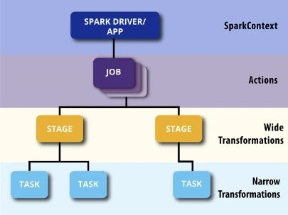

Slide 12
Stages are broadly classified as Shuffle Map Stage & Result Stage.
A Shuffle Map Stage is an intermediate Stage in the DAG that produces data for the Shuffle operations and the output is further used in the following stages in the DAG. Tasks associated with this type of Stage are called Shuffle Map Tasks. The output of this type of stage is saved as Shuffle Dependency and it stores the output location & number of output files.
A Result Stage is a final stage in the Job that applies the corresponding function on the partitions of the RDD to compute the result of the called action.
The computed result is then sent back to the Driver. The tasks associated with this stage are called Result Tasks

Slide 13
Spark Tasks → A task in Spark is the smallest unit of work that can be scheduled The single computation unit performed on a single data partition is called a task. It is computed on a single core of the worker node.
Each executor would then run a task in parallel, performing the transformations defined in that task on its subset of the data.
If your dataset has 2 Partitions, an operation such as a filter() will trigger 2 Tasks, one for each Partition
Each Stage is divided into several Tasks. One Task is launched per partition. So for an action as simple as counting rows of an RDD having 100 partitions, we will launch 100 tasks that will count the rows in those 100 partitions and report back to the driver to save the result. So a task can be termed as the smallest unit of execution.

Slide 14
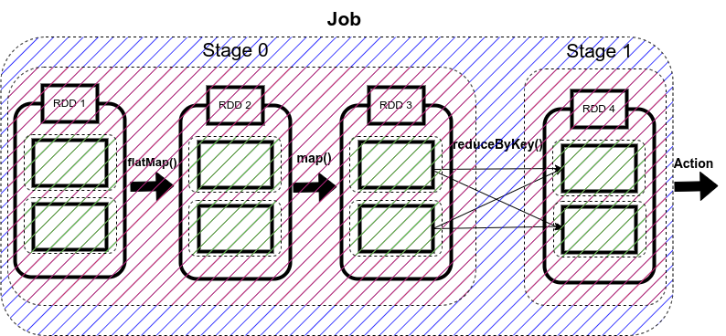

Slide 15
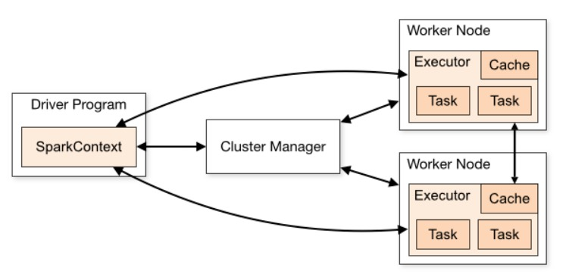

Slide 16
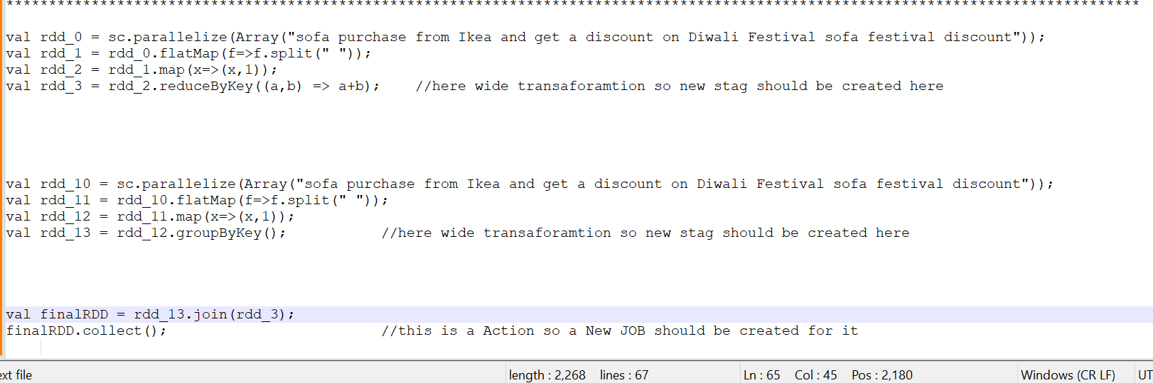

Slide 17
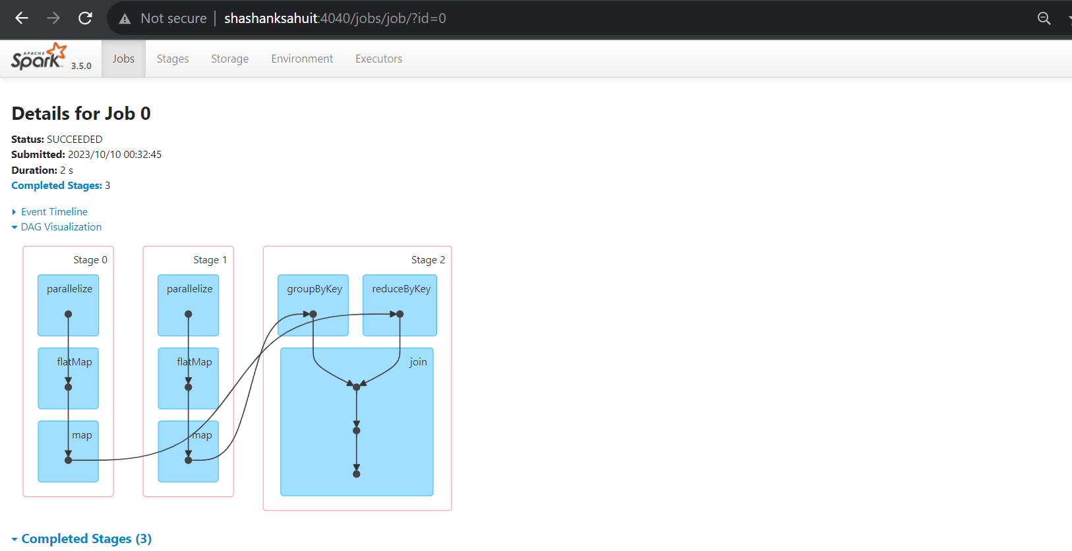

Slide 18
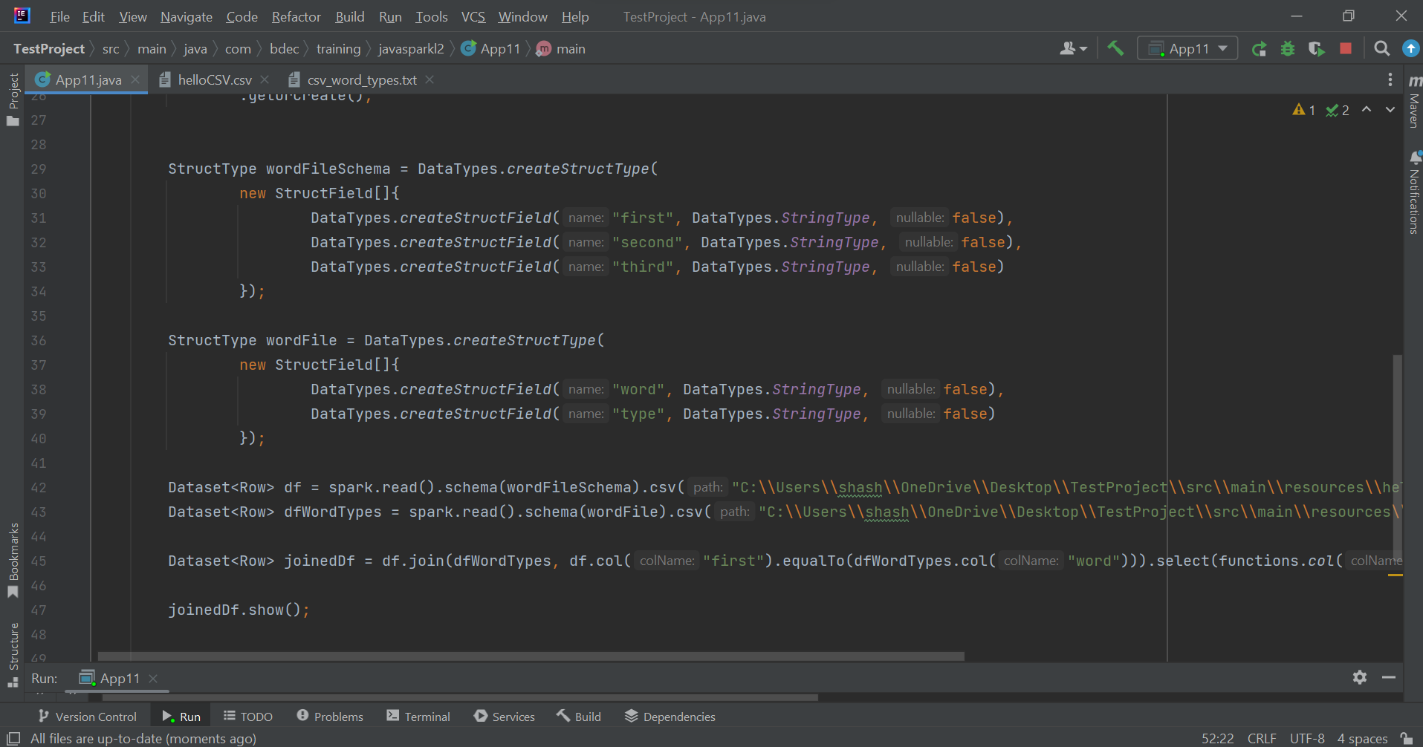

Slide 19
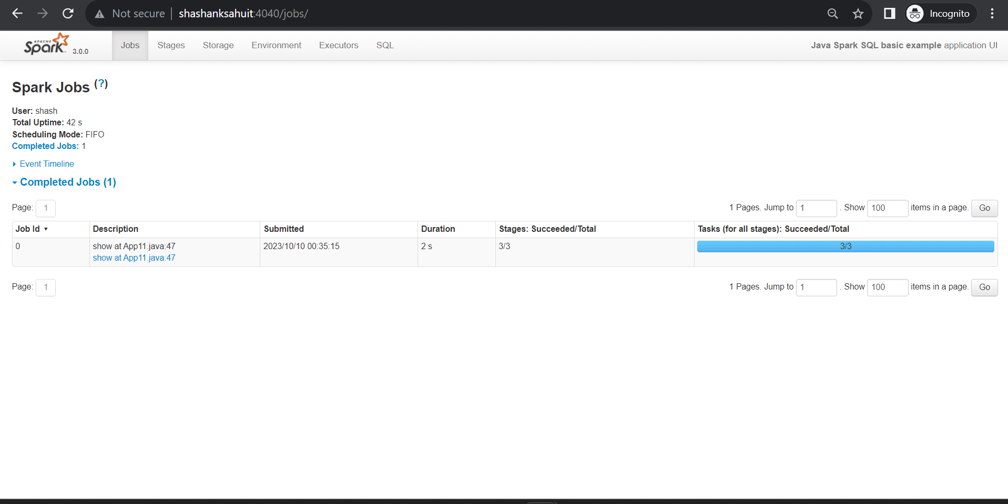

Slide 20
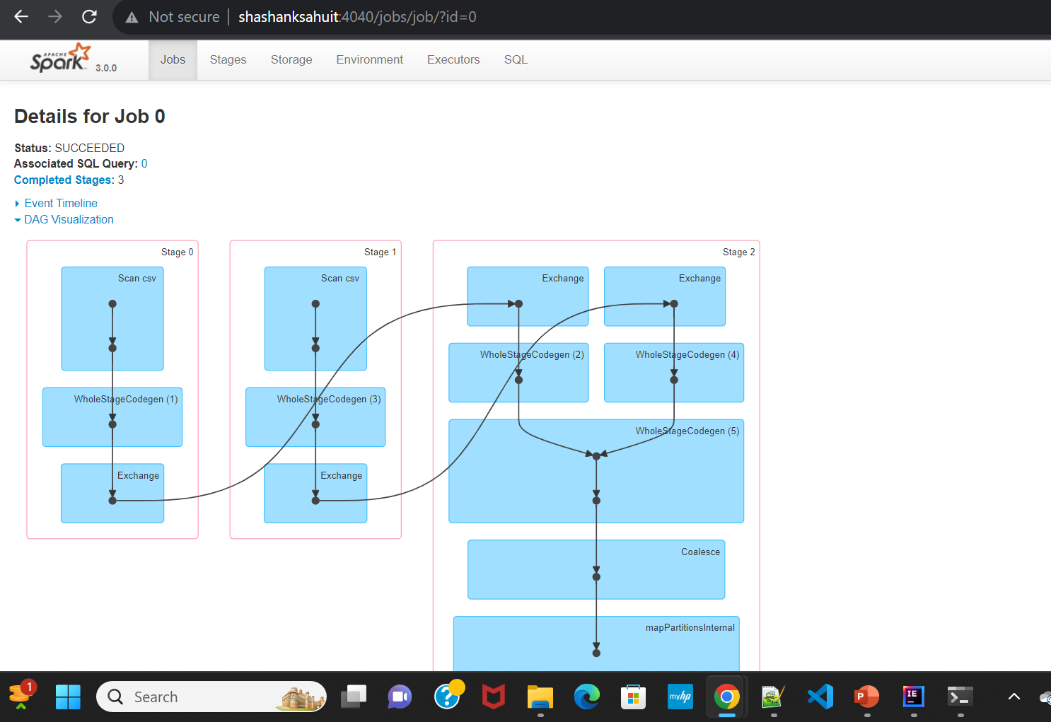

Slide 21
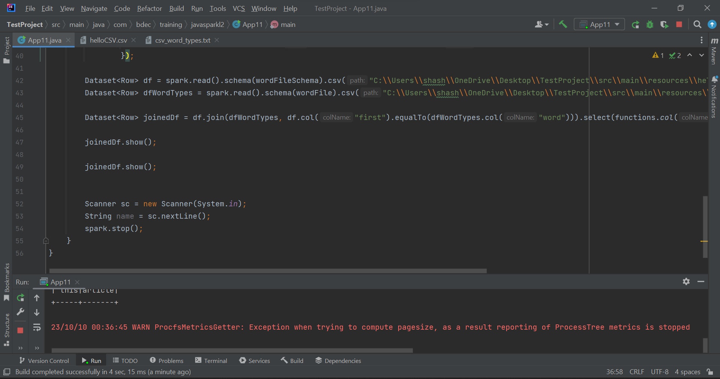

Slide 22
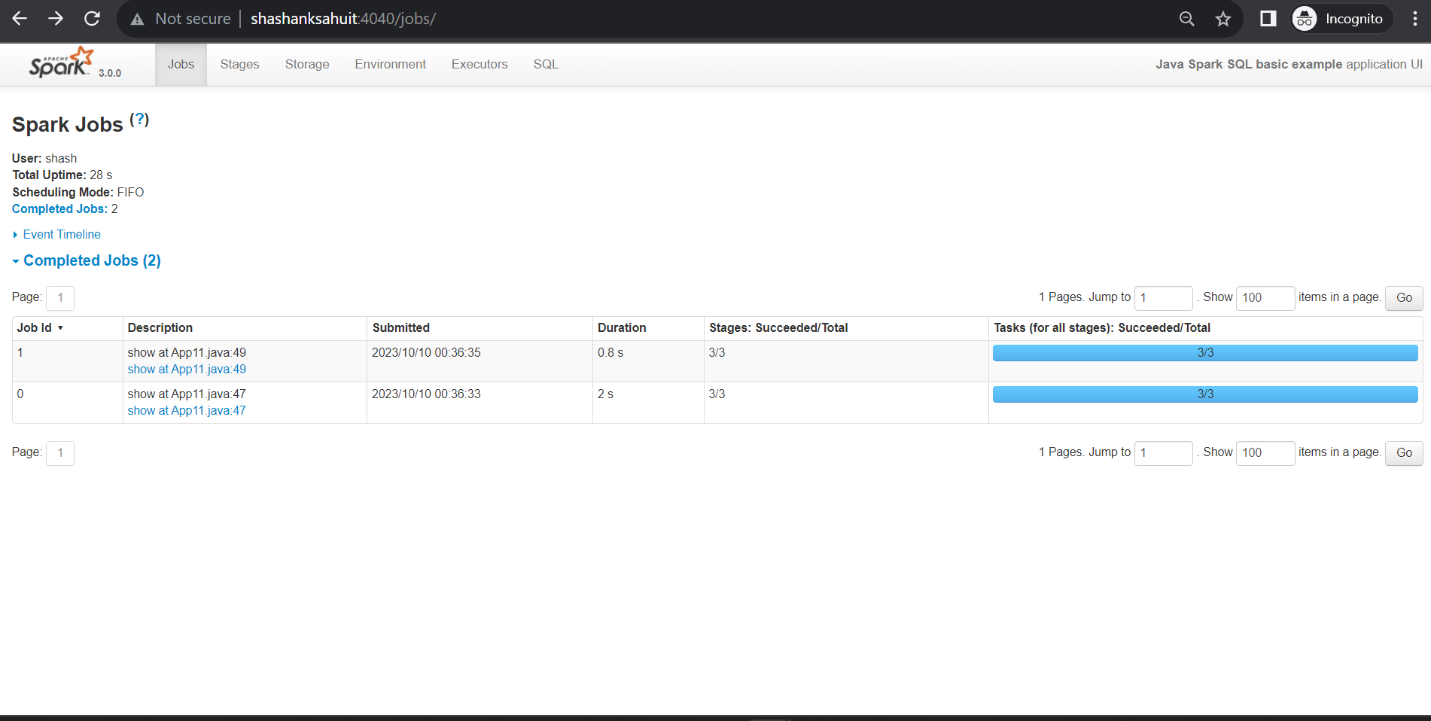

Slide 23
